Slide 1
Bokart
By Mech Mates

Slide 2


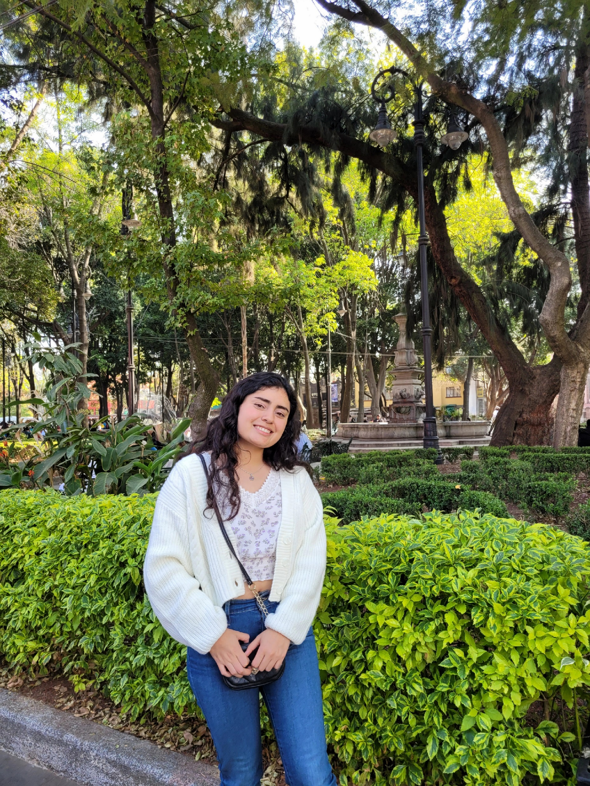
The team
Garcia Garcia Andony Abdala (BGSW/EBM1-MS)
Guerra Santibanez Elisa (BGSW/EBS3.1-SX)
Moreno Paz Ximena (BGSW/EBS3.1-SX)

Slide 3
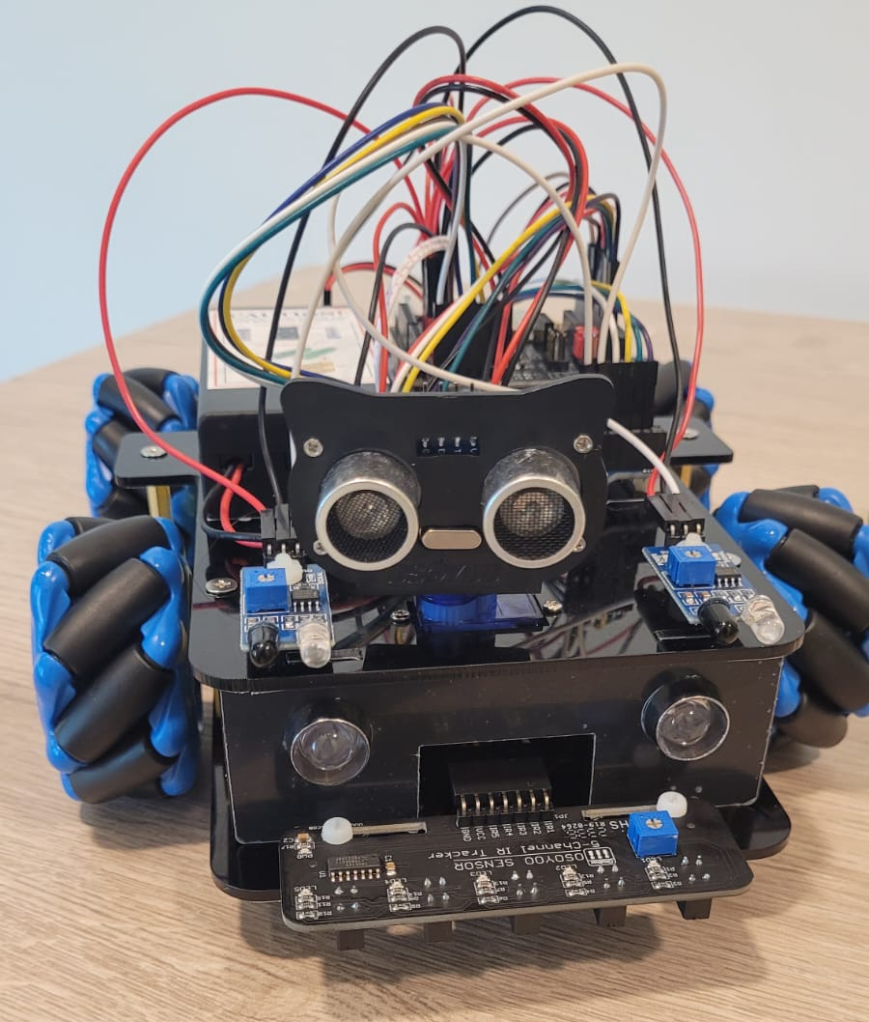
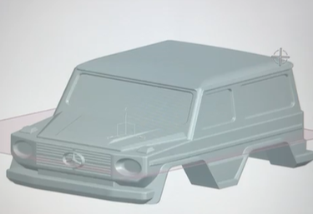
Bot design

Slide 4
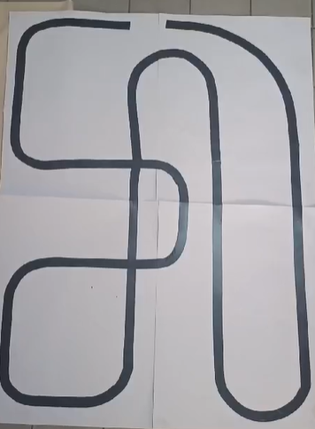
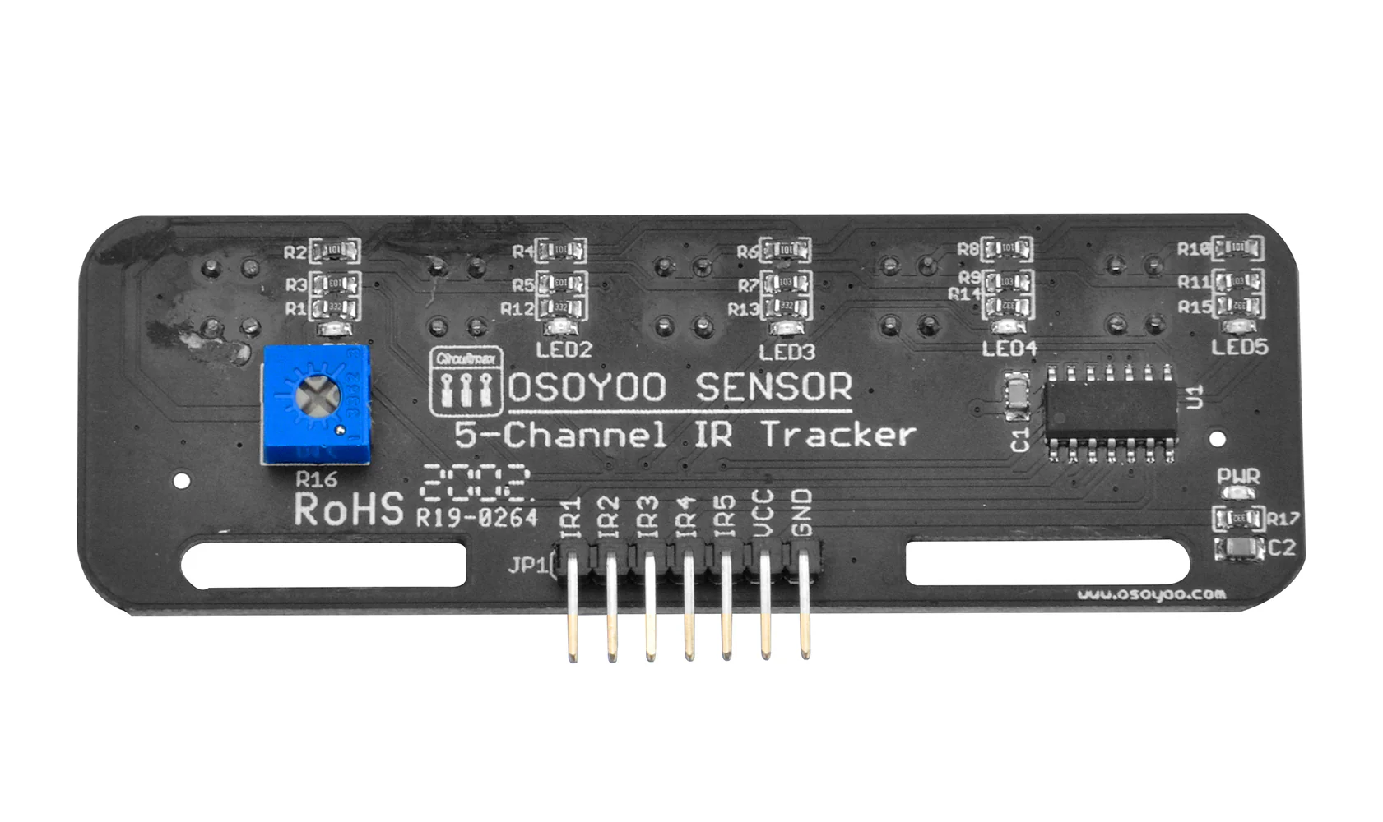
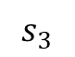
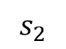
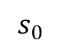
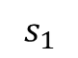
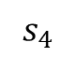
Line following logic
$$s_{0}$$
$$s_{1}$$
$$s_{2}$$
$$s_{3}$$
$$s_{4}$$
-4
-2
0
2
4
$$error=\left(−4\right)s_{0}+\left(−2\right)s_{1}+\left(0\right)s_{2}+2s_{3}+4s_{4}$$
$$speed={(k}_{p})error+\left(k_{i}\right)integral+\left(k_{d}\right)derivative$$
Cross-line handle
No-line handle
“Go forward”
“Go backwards”

Slide 5
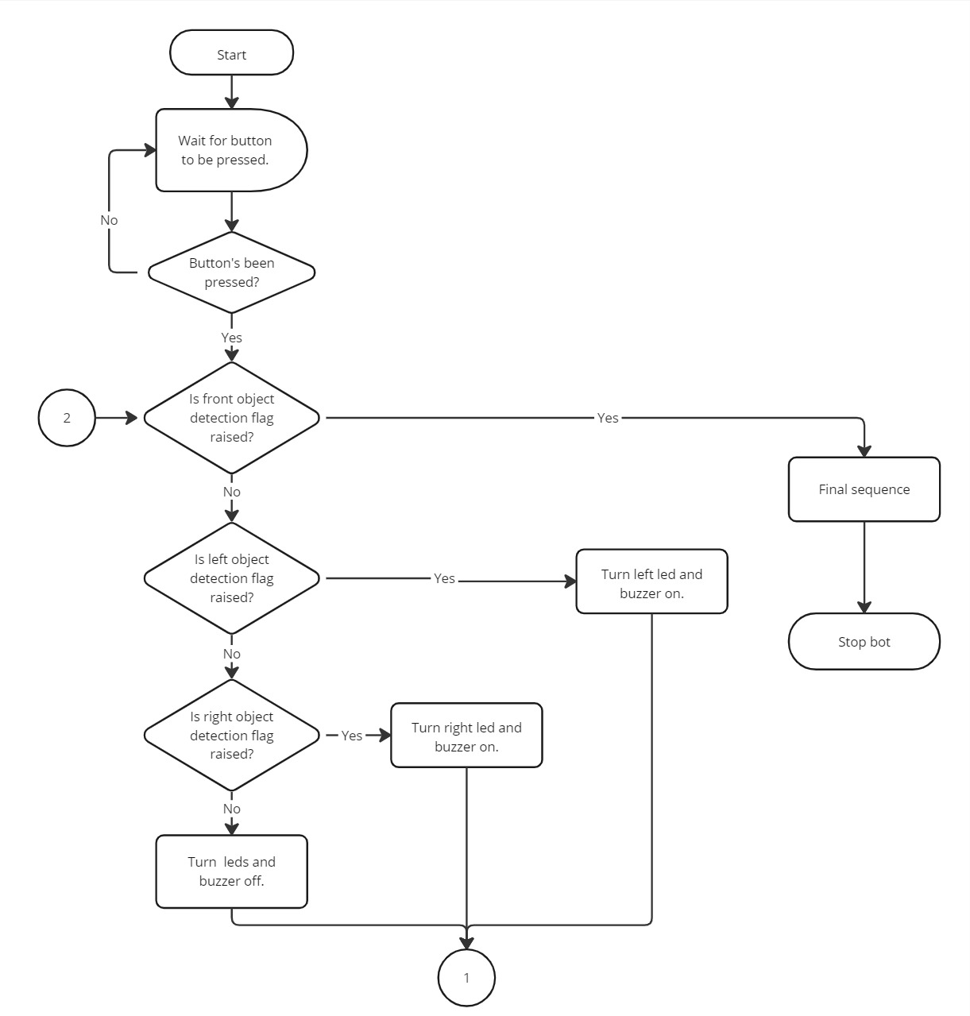
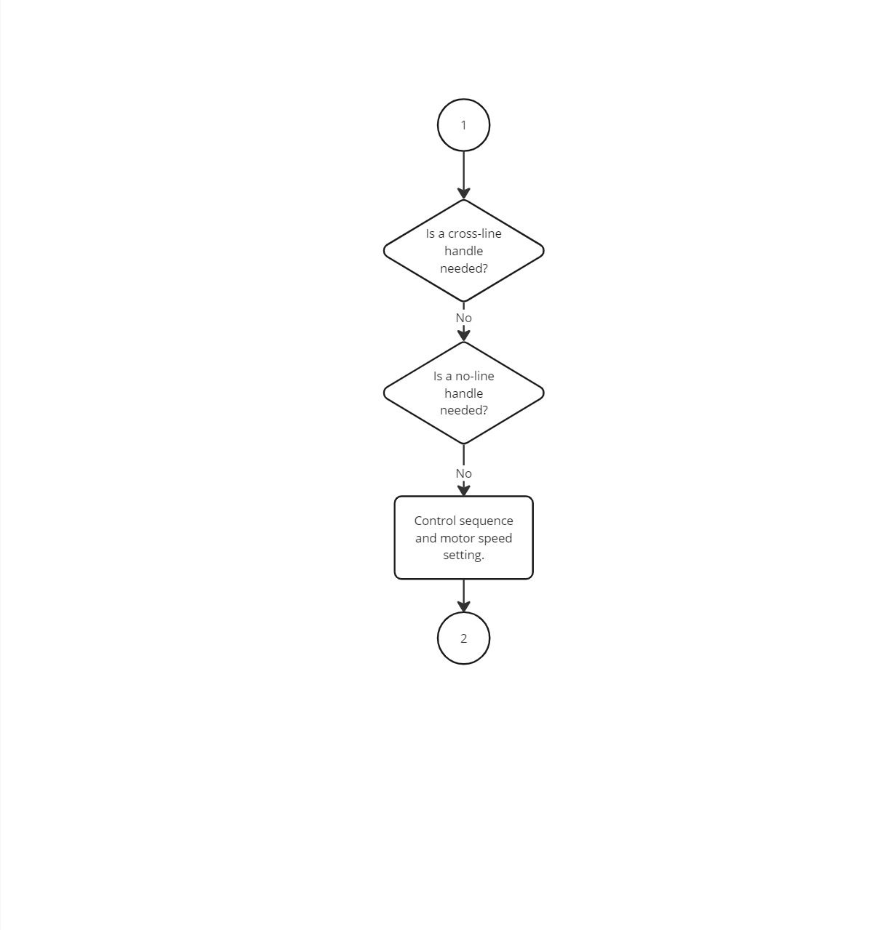
The code

